Slide 1



FoCo ECo
Fort Collins Environmental Collective

Slide 2

FoCo ECo
Fort Collins Ecological Collective

Slide 3
FoCo ECo
Fort Collins Ecological Collective

Slide 4


Slide 5


Slide 6


Slide 7


Slide 8






Slide 9
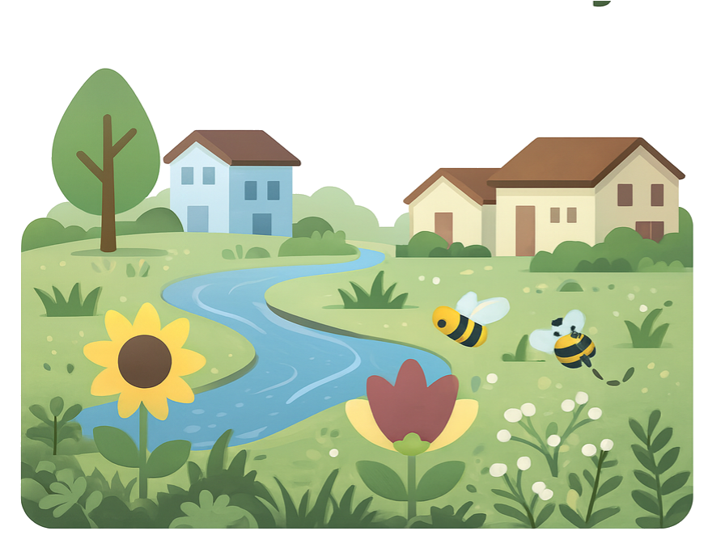

Slide 10
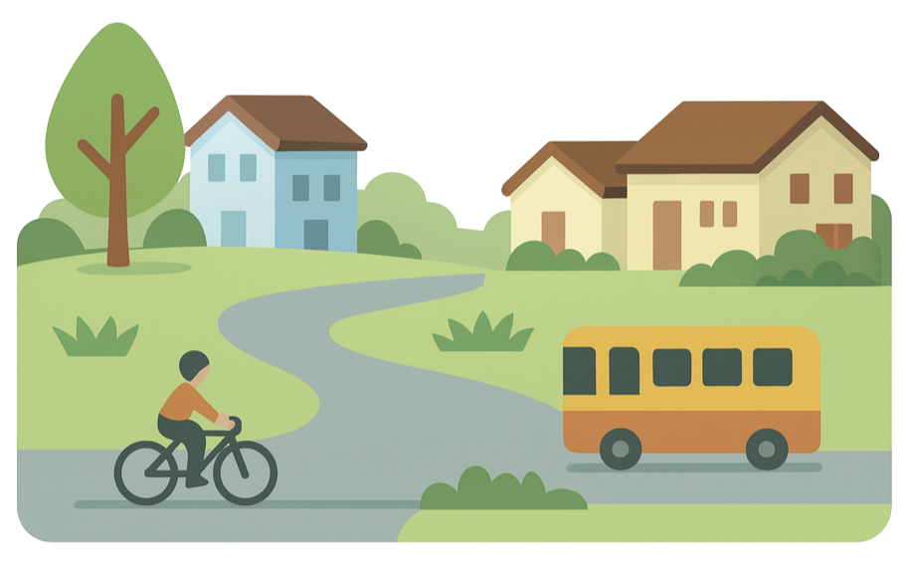

Slide 11


Slide 12


Slide 13


Slide 14
